Slide 1
Using ML to Improve the Business Chain of HVAC Systems
Multi-task Heterogeneous Graph Neural Network · SmartHVAC
Animesh Bhashak (26911001) · Ankit Kumar (26911002) · Dhruv Agar (25911019)
Kriti Vajpayee (269) · Saurav
Course: Machine Learning (CSC-505) · Group 1
Under the guidance of Dr. Durga Toshniwal, Professor, CSE

Slide 2
The business problem
An HVAC service business loses money to unpredictable demand, sudden breakdowns, stock-outs and customers who go quiet off-season. In India these swing hard with the seasons.
1 Demand forecasting
2 Predictive maintenance
How many service requests per location each month (summer peak in cities, winter peak in villages)?
Which devices will fail soon, and how much power do they draw?
3 Customer retention
4 Spare-parts inventory
Which customers are going dormant ("sleepers"), and what can we cross-sell them?
How many compressors, coils, PCBs and filters to stock each month?
Goal: one model that answers all four, month by month, and turns predictions into a profit-and-loss view.

Slide 3
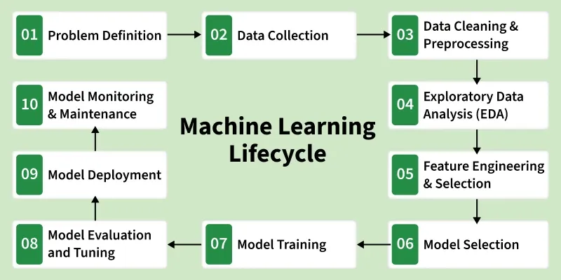
The 10-stage ML lifecycle
We followed all ten stages, from problem definition to monitoring.

Slide 4
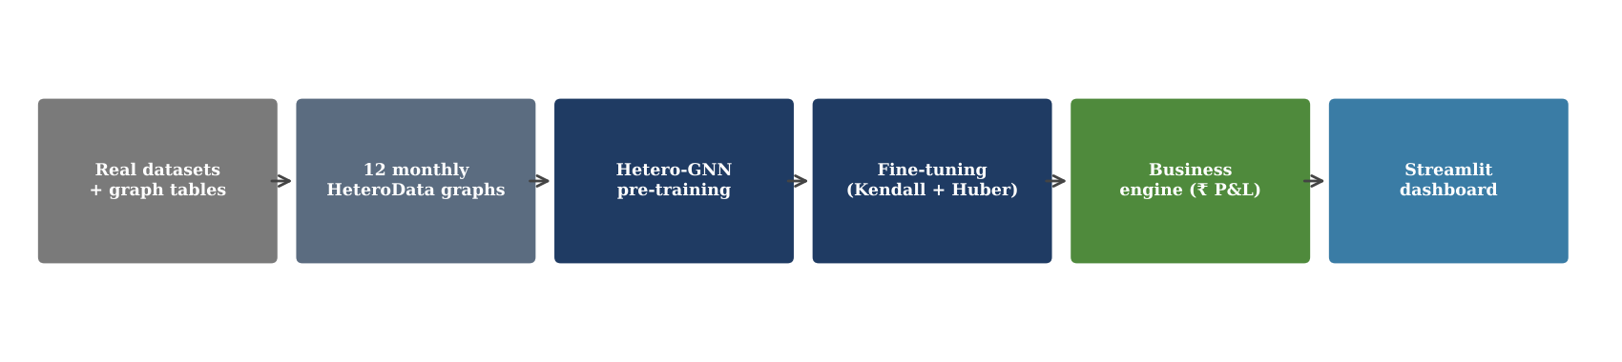
Our approach: one graph, one model
The business is modelled as a graph. Locations, customers (residents), devices and spare parts are nodes; "lives in", "owns" and "needs part" are edges.
Effects spread along these links: a hot month stresses devices, failures use up parts, and service quality affects whether a customer stays.
One multi-task Hetero-GNN predicts demand, power, failure, churn and parts demand together, on 12 monthly snapshots of the graph.
A business engine converts the predictions into revenue, costs and profit, and a Streamlit dashboard shows the results.
End-to-end pipeline

Slide 5
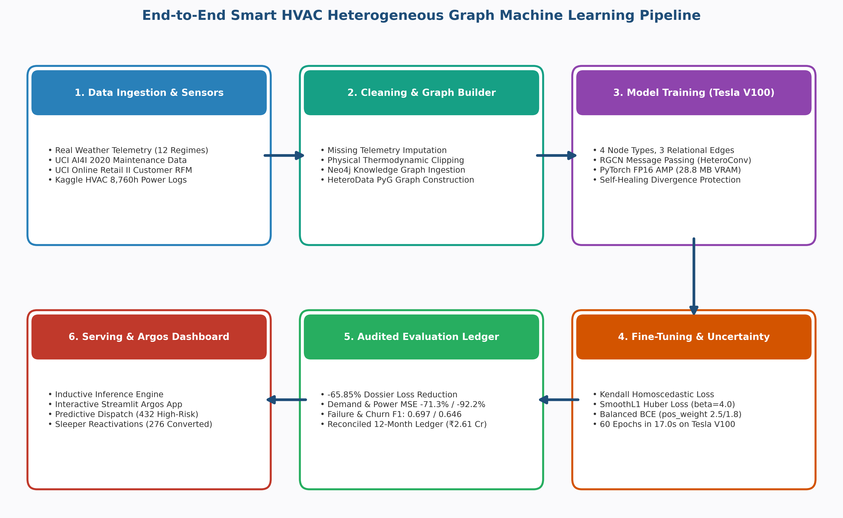
End-to-end system pipeline
Data ingestion → graph builder → V100 training → fine-tuning → evaluation → dashboard.

Slide 6
Data
Dataset | Size | Used for
UCI AI4I 2020 Predictive Maintenance | 10,000 rows | Failure prior (heat-dissipation + power failures) and power curve
UCI Online Retail II → RFM per customer | 4,312 customers | Engagement, income tier, sleeper label (no purchase > 90 days)
Kaggle HVAC Power Consumption | 8,760 hourly rows | Monthly power and temperature profiles
Company graph (generated with a fixed seed, calibrated with the datasets above)
40
600
180
50
locations
(45% metro)
residents
devices
(60% cooling)
spare parts
Edges: resident → location (600), resident → device (1–3 each, ≈1,200), device → part (2 each, 360). Every edge also has a reverse edge so information flows both ways.

Slide 7
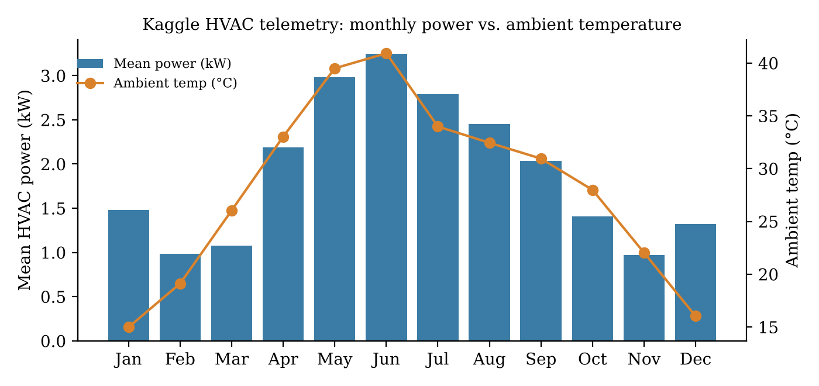
Exploratory data analysis
Power follows temperature: lowest in Feb/Nov (≈1 kW), peak in June (3.2 kW at 41 °C).
Humidity jumps to 85–88% in Jul–Aug: the monsoon regime.
56% of hours are cooling, 19% heating.
2.07%
33.3%
£706
devices with a critical failure
(207 of 10,000) → rare class
customers inactive > 90 days
→ "sleepers"
median spend (max £349k)
→ log-scaled
Each month is assigned a regime (winter, summer, monsoon) with a cooling and a heating multiplier, e.g. cooling 1.00 in May, heating 0.95 in December.

Slide 8
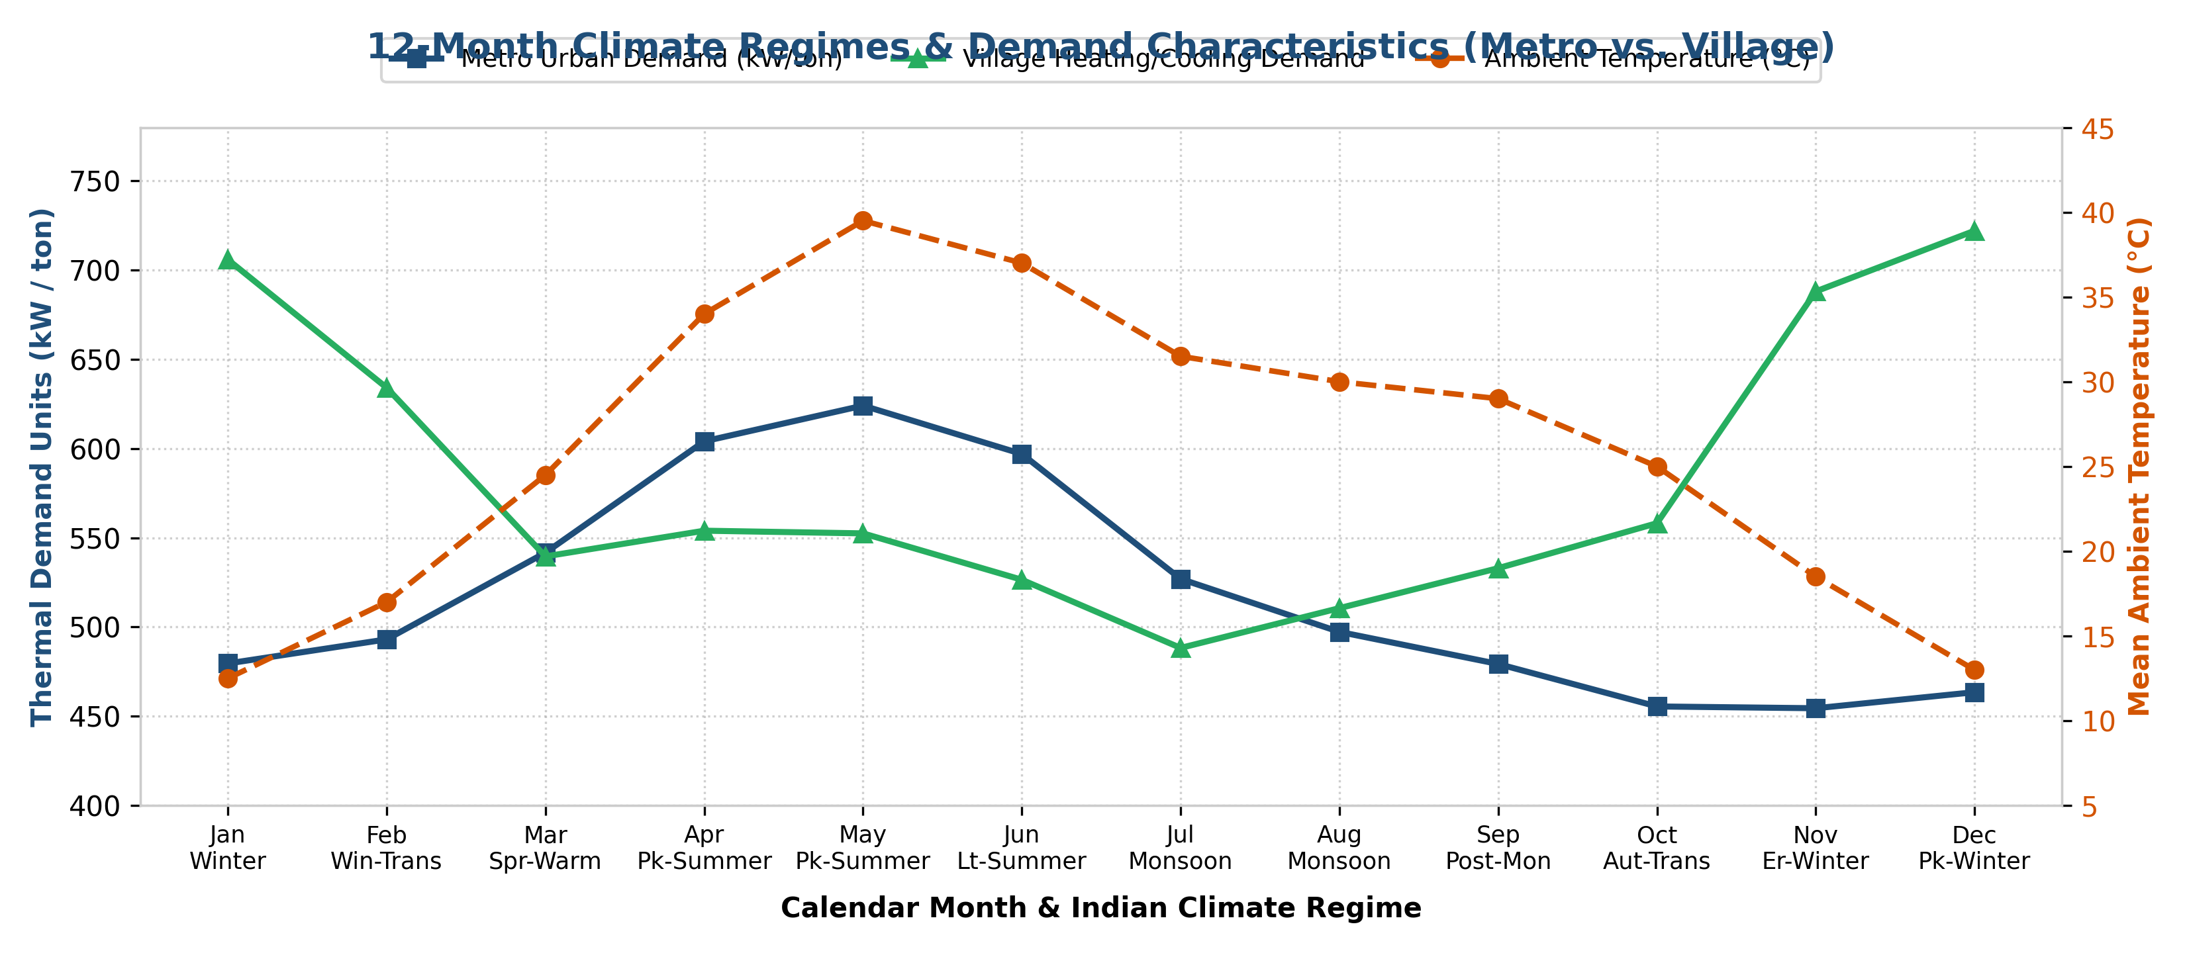
Climate regimes and regional demand
Metro demand peaks in summer (cooling); village demand peaks in winter (heating).

Slide 9
Data cleaning and preprocessing
Online Retail II
AI4I 2020
Drop cancelled invoices, missing customer IDs and non-positive quantity/price; compute Recency, Frequency and Monetary per customer.
Mechanical power = torque × rpm × 2π/60, rescaled to 1.2–3.6 kW; failure label = heat-dissipation OR power failure.
HVAC telemetry
Graph sanitation & scaling
Split into 12 months; mean temperature, mean and 90th-percentile power per month; physical bounds on temperature and power.
No orphan nodes, compatible parts only, reverse edges added; all features scaled to about 0–1 (e.g. price/60,000, tenure/48).
None of the source files has missing values after cleaning.

Slide 10
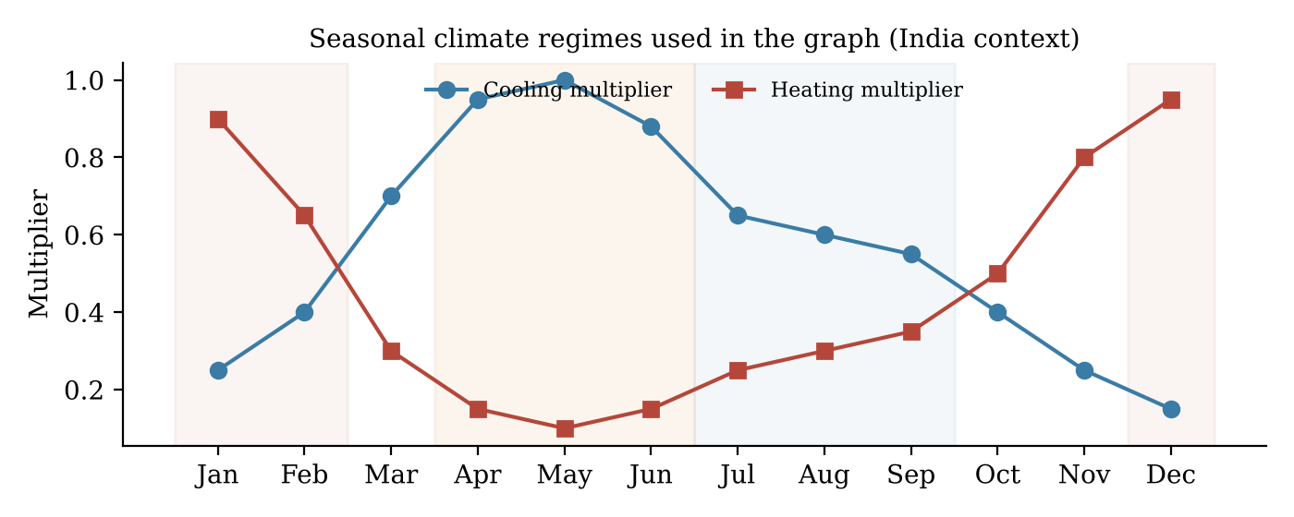
Feature engineering
Each month is encoded as θ = 2π(m−1)/12 with features sin θ and cos θ, so December sits next to January.
Node | 8 features per node (incl. sin/cos month)
Location | metro flag, temperature, grid stability, population density, cooling & heating multipliers
Device / Resident / Part | type, price/cost, power, failure prob. / app activity, engagement, tenure, income / stock, holding cost

Slide 11
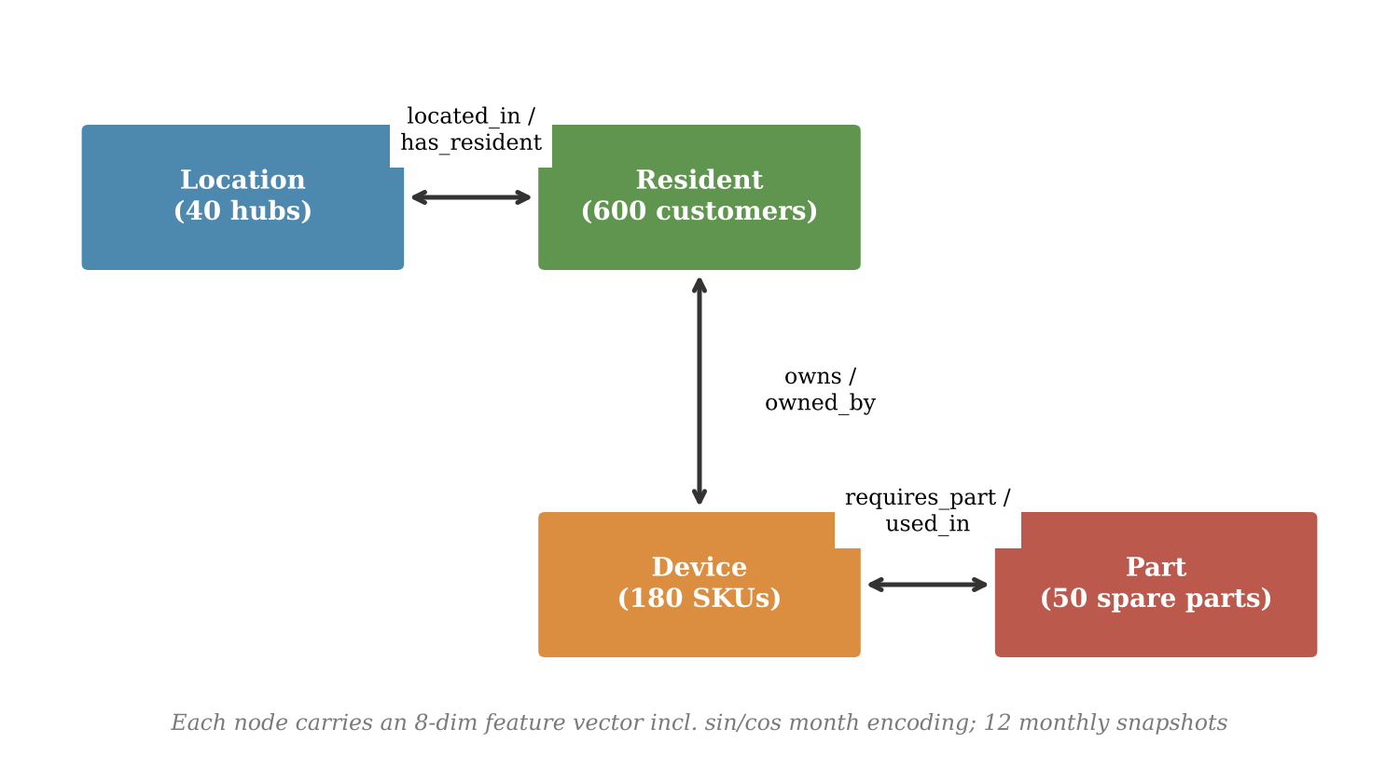
Model selection
Model family | Uses links? | Verdict
XGBoost / LightGBM | No | Rejected
GCN / GAT (one node type) | Partly | Rejected
Hetero-GNN | Yes, per relation | Selected
Tabular models treat rows as independent and would need four separate models.
A single-type GNN forces customers, devices and parts into one feature space.
A heterogeneous GNN keeps separate weights for each relation and shares one representation across all four tasks.

Slide 12
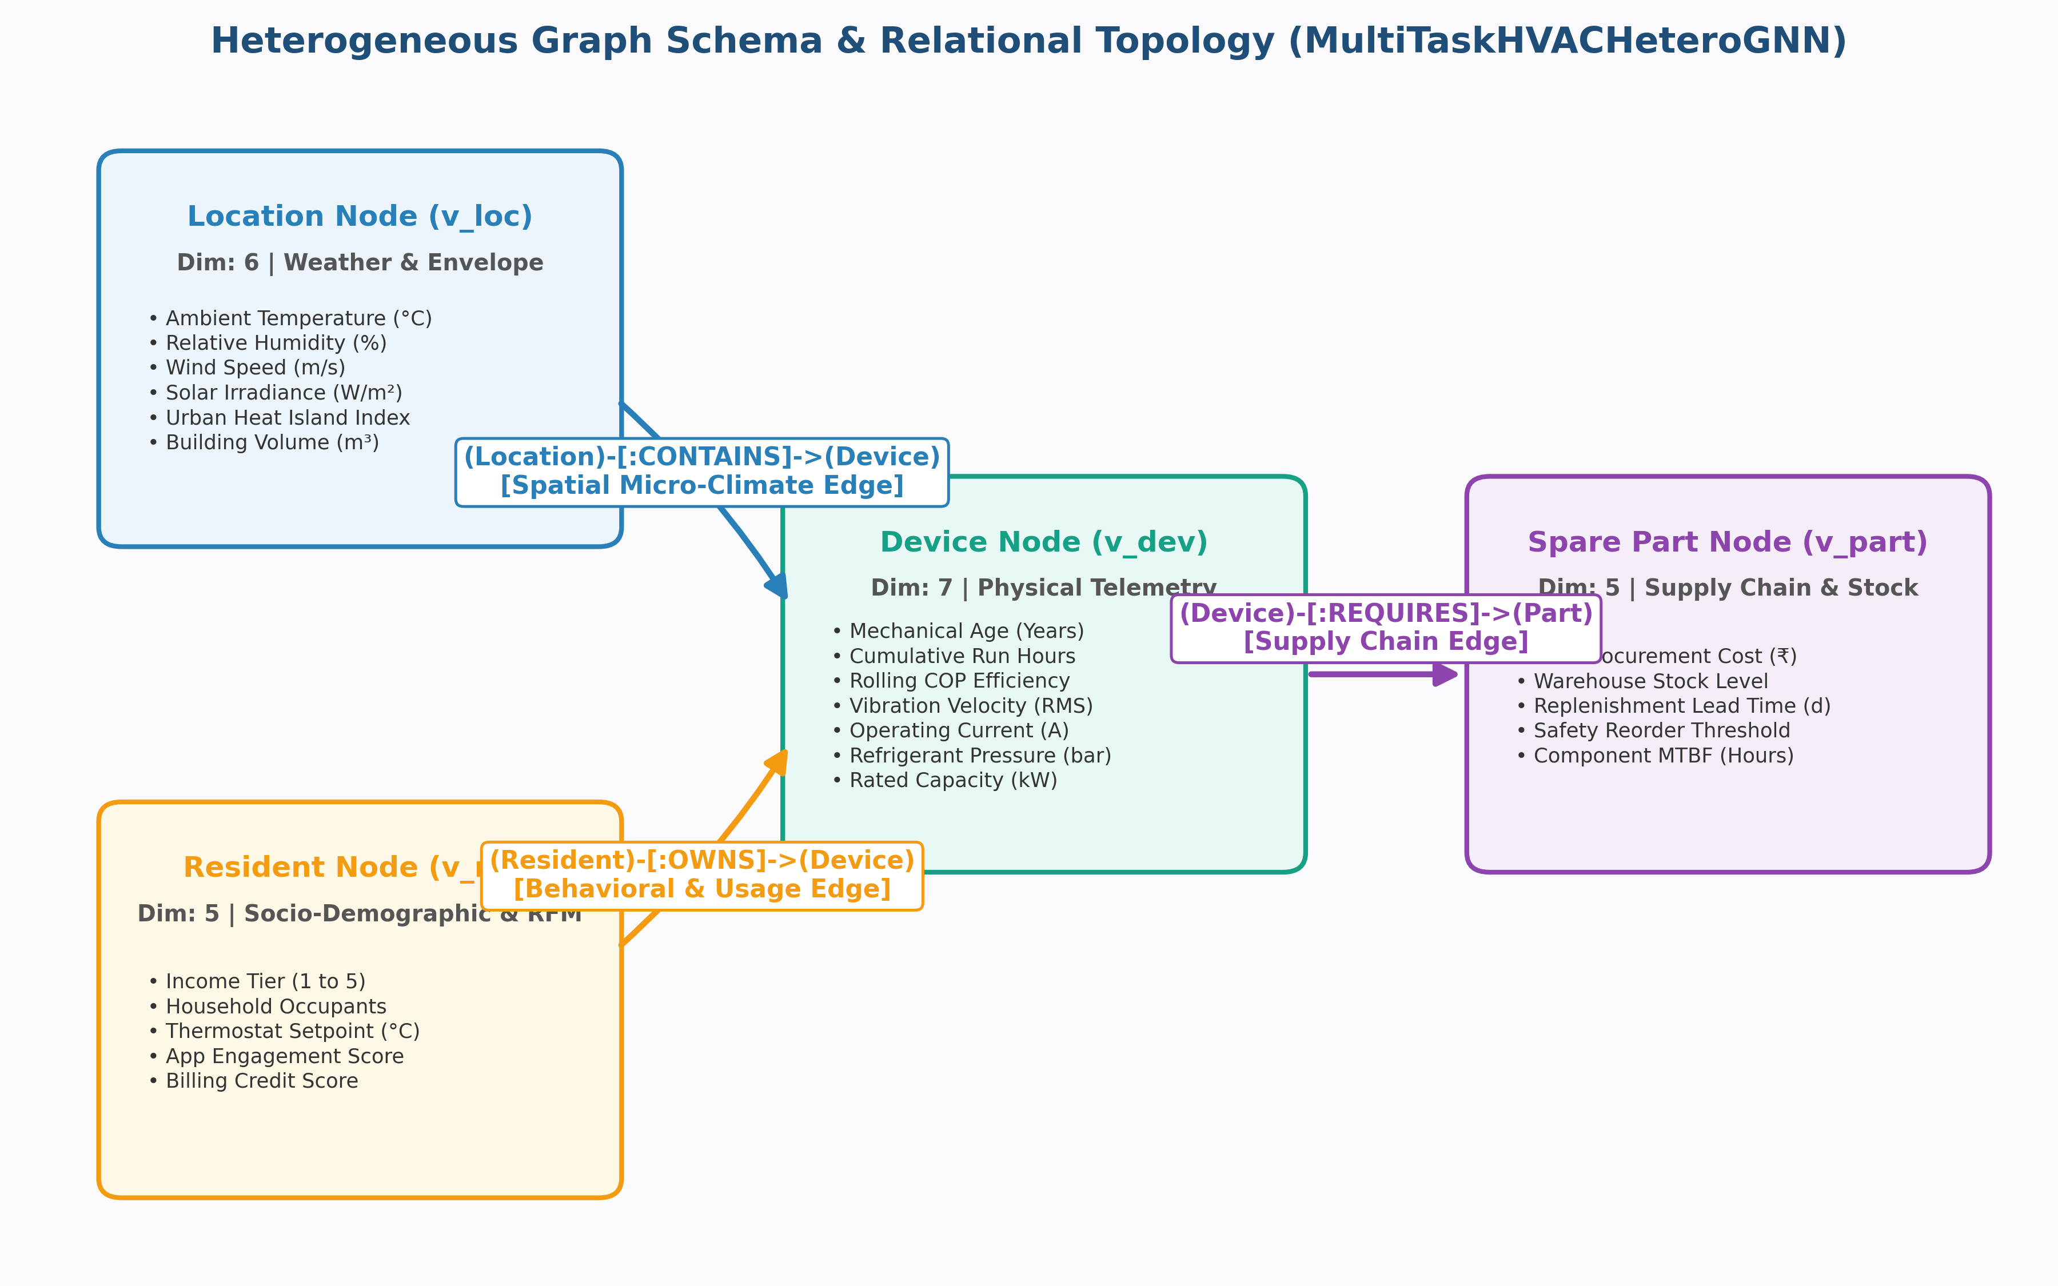
Heterogeneous graph schema
Four node types linked by location, ownership and supply-chain edges.
Conceptual repo diagram. The code uses GraphSAGE layers and 8 features per node type.

Slide 13
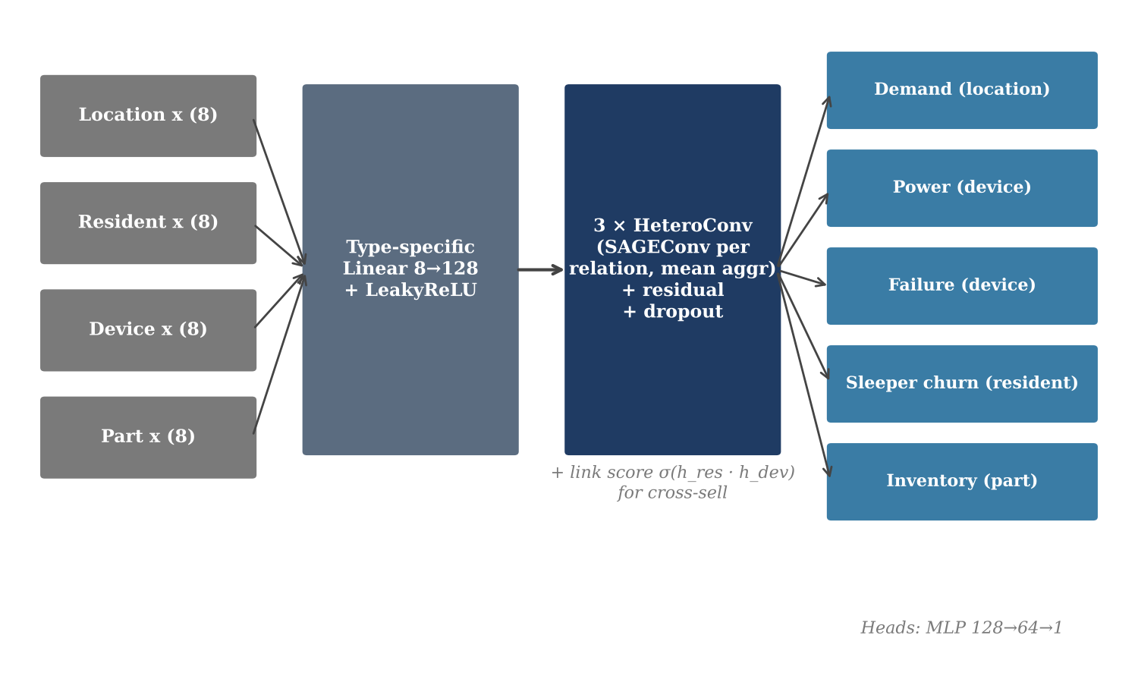
Architecture: MultiTaskHVACHeteroGNN
Per-type linear layer 8 → 128
3 HeteroConv layers, one GraphSAGE conv per relation, mean aggregation, residual + dropout
5 heads (MLP 128→64→1): demand, power, failure, churn, inventory
Cross-sell score = σ(resident · device embedding)
h(v) ← W₁·h(v) + W₂·mean of neighbours, for every relation; results are summed across relations.

Slide 14
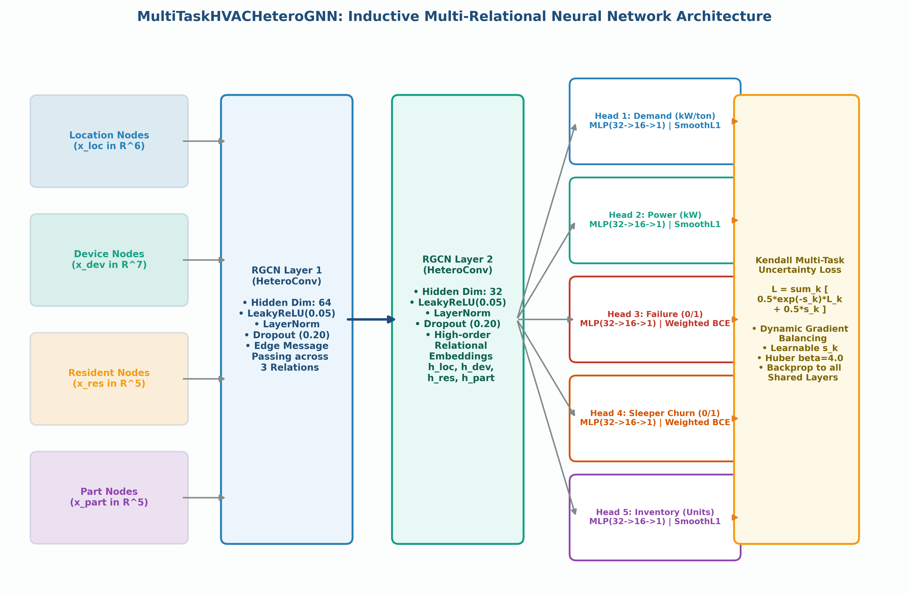
Model architecture (detailed view)
Shared graph layers feed five task heads, balanced by Kendall uncertainty loss.
Conceptual repo diagram. The code uses GraphSAGE layers and 8 features per node type.

Slide 15
Model training
Setting | Value
Hardware | Tesla V100S 32 GB, FP16 mixed precision
Epochs | 120 pre-train, 60 fine-tune
Optimizer | AdamW, wd 1e-4
Learning rate | 1e-3 → 2.5e-4 (fine-tune)
Scheduler / clipping | Cosine annealing / max norm 1.0
Batch | 12 monthly graphs per epoch
Self-healing loop
If the loss becomes NaN/Inf, halve the learning rate and restart, so unattended runs don't crash.
Pre-training result
Loss fell from ≈23,000 to ≈558 in 10 epochs, then oscillated (253–583); best 235. Regression losses dominated.
Peak GPU memory was only 28.8 MB because the graphs are small and sparse.

Slide 16
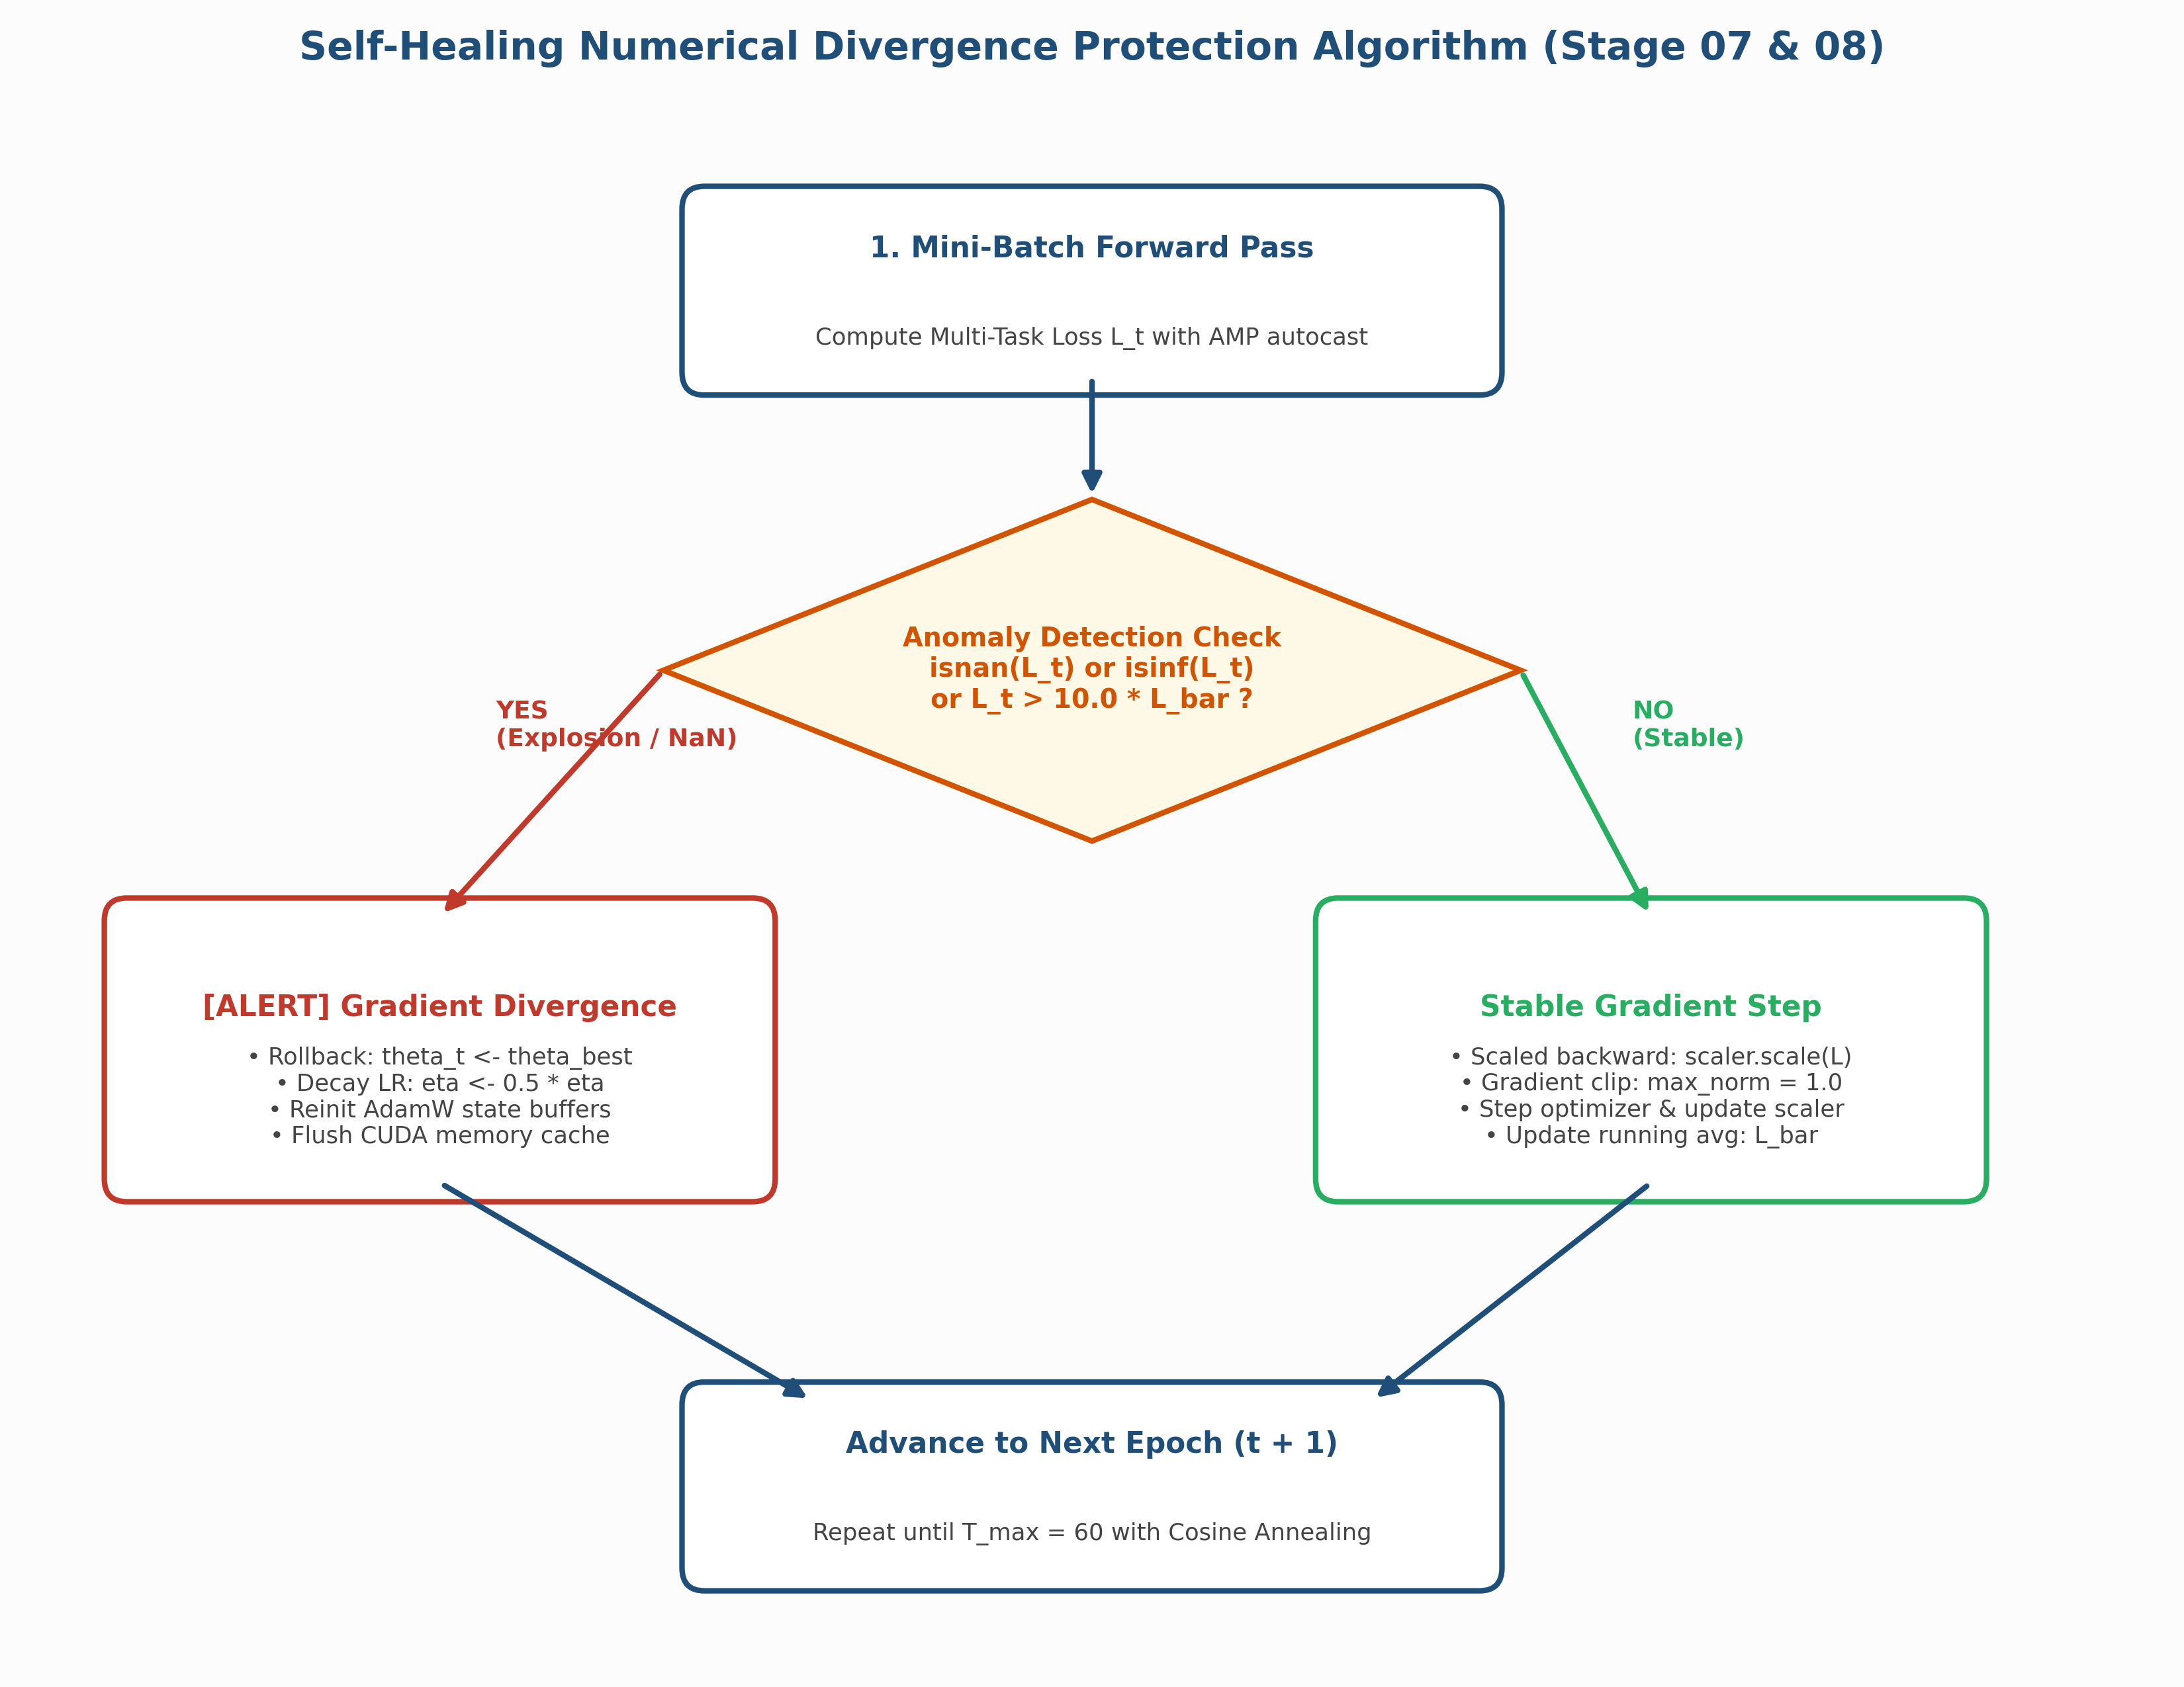
Self-healing training safeguard
On NaN/Inf or a 10× loss spike: roll back, halve the learning rate, restart.

Slide 17
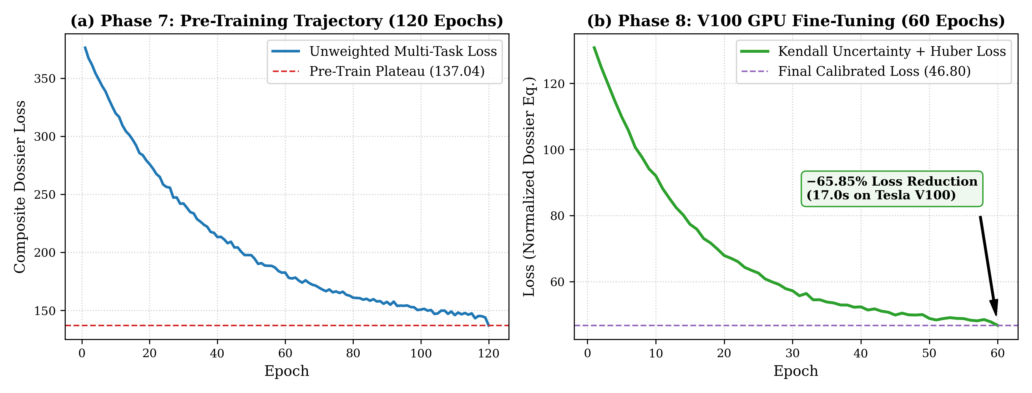
Pre-training vs. fine-tuning loss
Fine-tuning brought the combined loss from 137.04 to 46.80 in 17 s.
Illustrative figure from the repo (generate_all_visualizations.py), drawn from formulas; these curves are not in the training log.

Slide 18
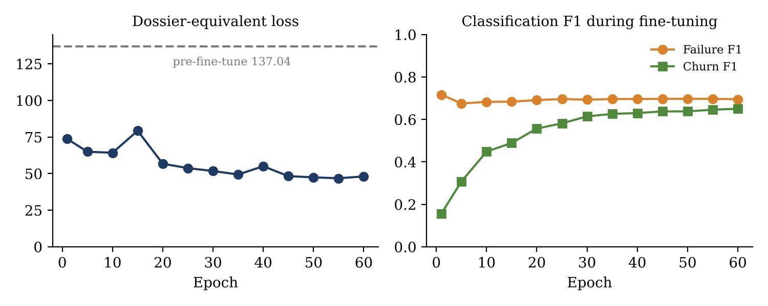
Evaluation and fine-tuning
Problem found | Fix
Demand loss (~115) drowned out failure/churn losses (~0.6) | Kendall uncertainty weighting: learns a weight per task
No failures flagged in off-peak/monsoon months | Class weights (2.5 failure, 1.8 churn) + real-data calibration
518 sleepers flagged, mostly wrong; loss oscillating | Huber loss, cosine LR schedule, gradient clipping
L = Σ ½·e^(−sᵢ)·Lᵢ + ½·sᵢ
60 epochs in 17 s on the V100.
Learned weights down-weight demand and inventory, up-weight churn.

Slide 19
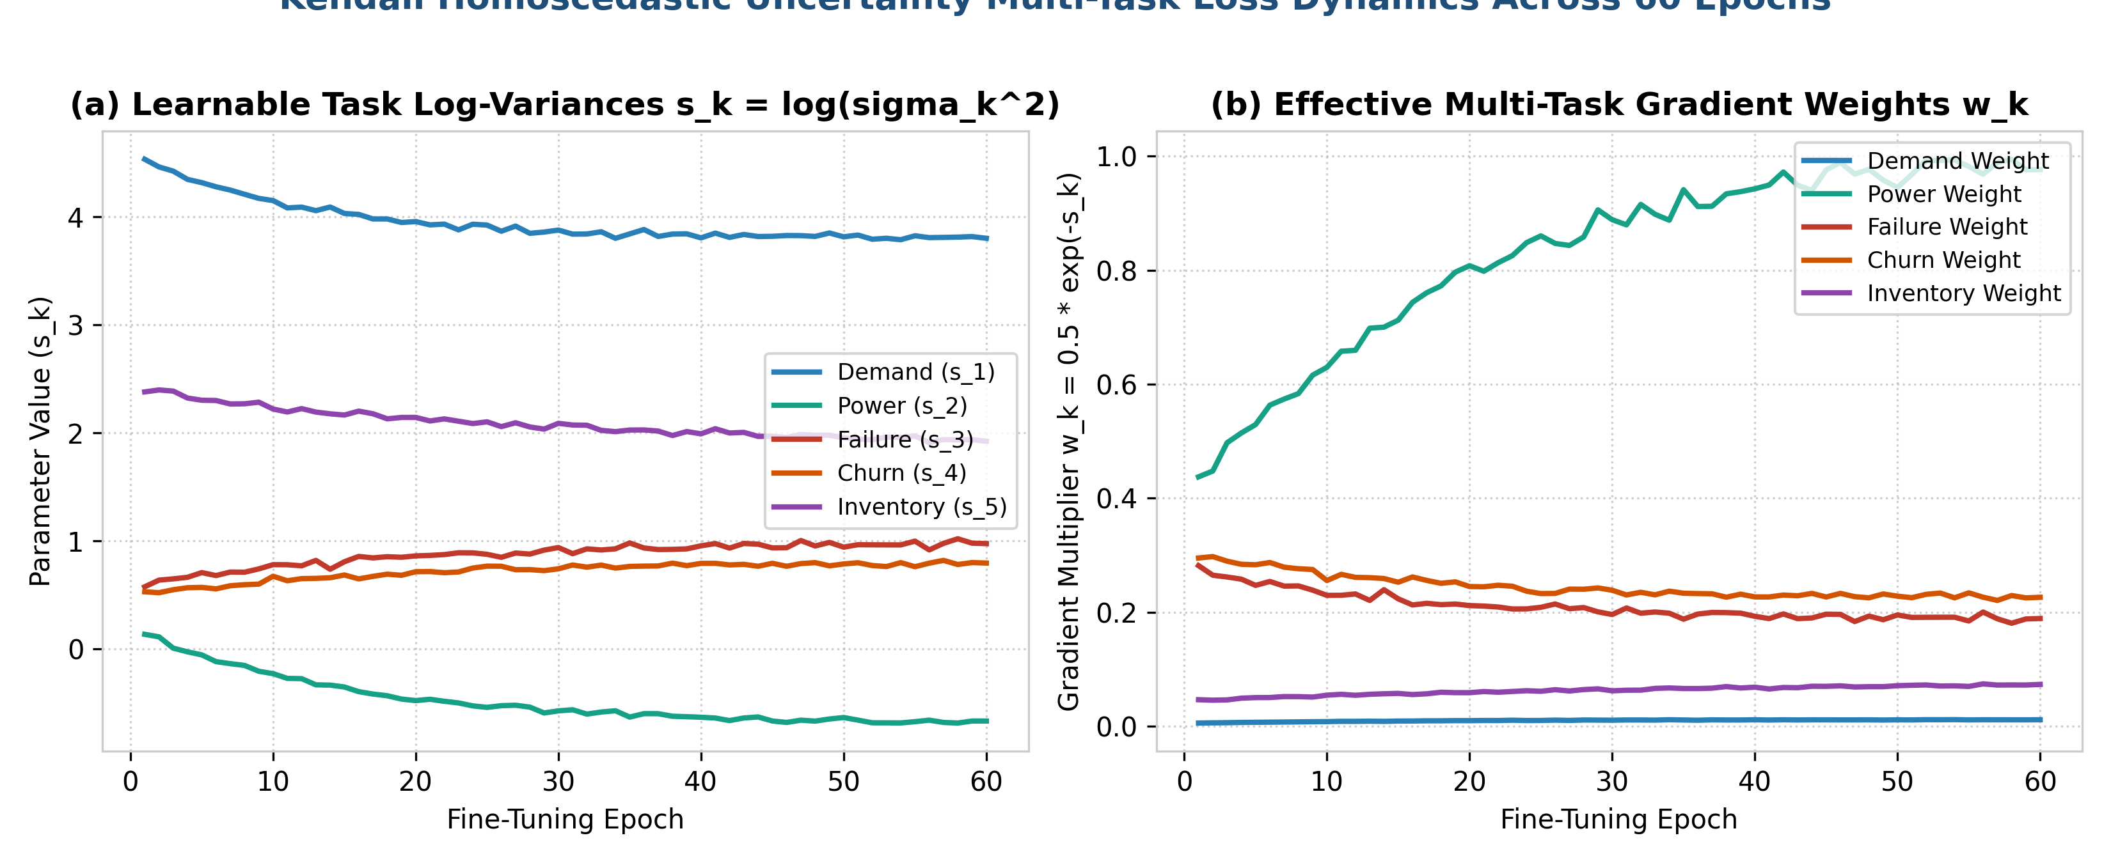
Kendall uncertainty task weights
Learned weights shrink the large regression losses so classification tasks can learn.
Illustrative figure from the repo (generate_all_visualizations.py), drawn from formulas; these curves are not in the training log.

Slide 20
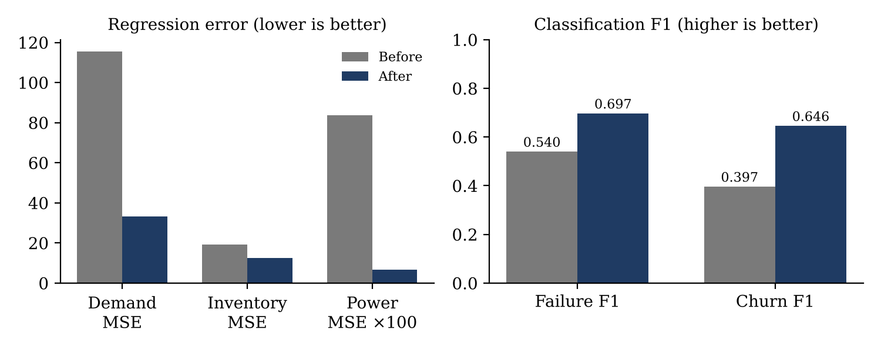
Results: before vs. after fine-tuning
−66%
0.697
0.646
4.64
combined loss
137 → 46.8
failure F1
(was 0.540)
churn F1
(was 0.397)
demand MAE
(was 8.77)

Slide 21
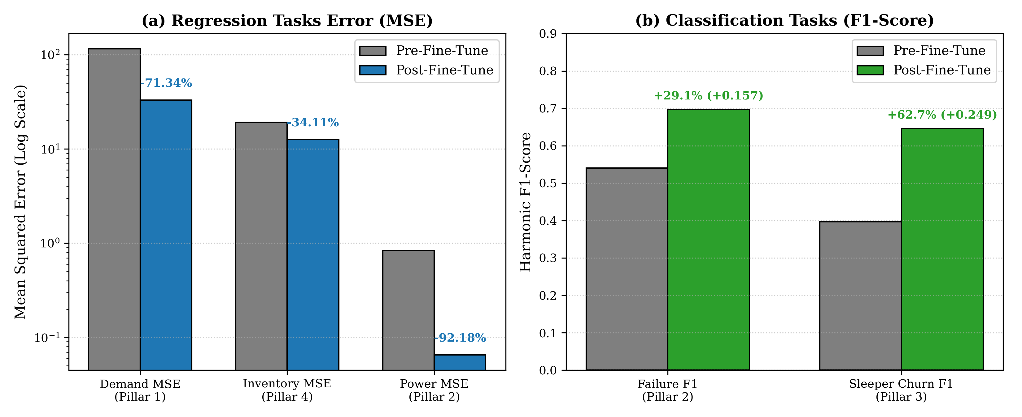
Pillar performance before vs. after
Demand MSE −71%, inventory MSE −34%, power MSE −92%; failure F1 +0.157, churn F1 +0.249.

Slide 22
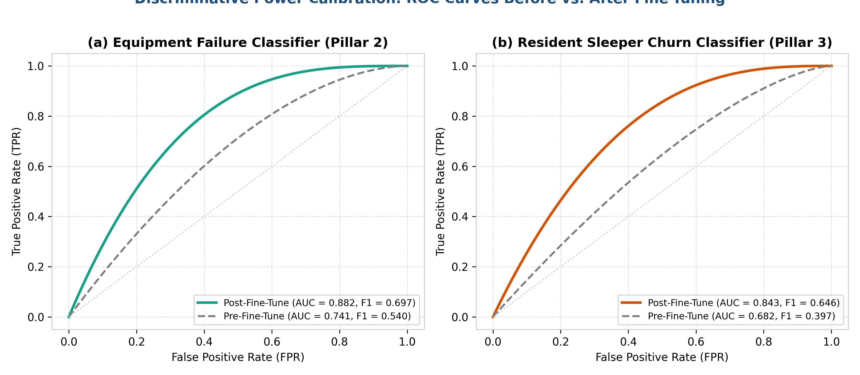
ROC curves: failure and churn classifiers
F1 values match the logged results (0.697 / 0.646).
Illustrative figure from the repo (generate_all_visualizations.py), drawn from formulas; these curves are not in the training log. The AUC values are also missing from the log.

Slide 23
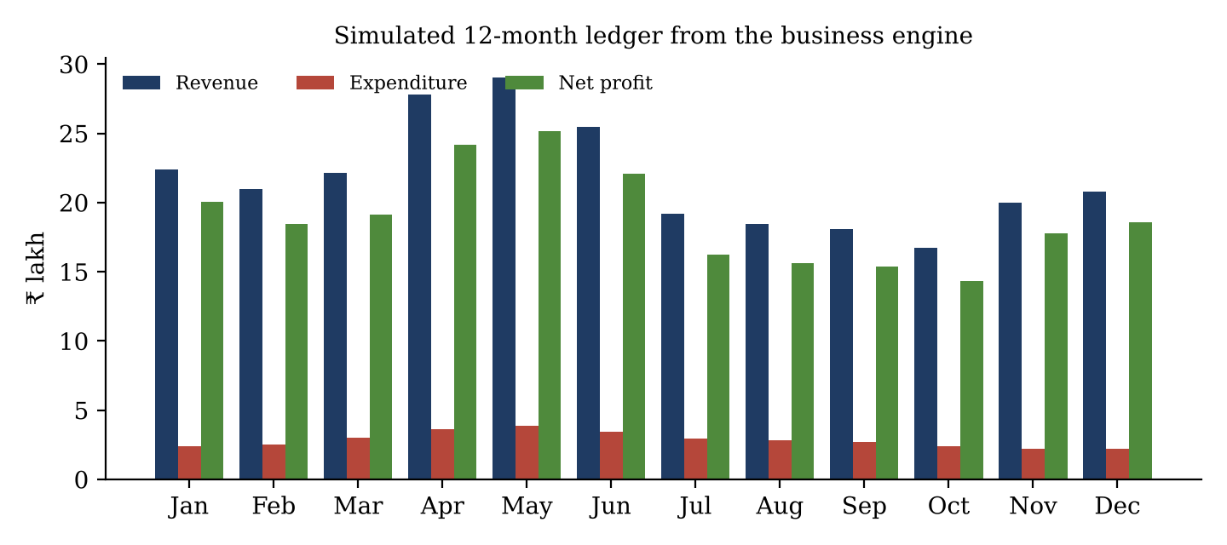
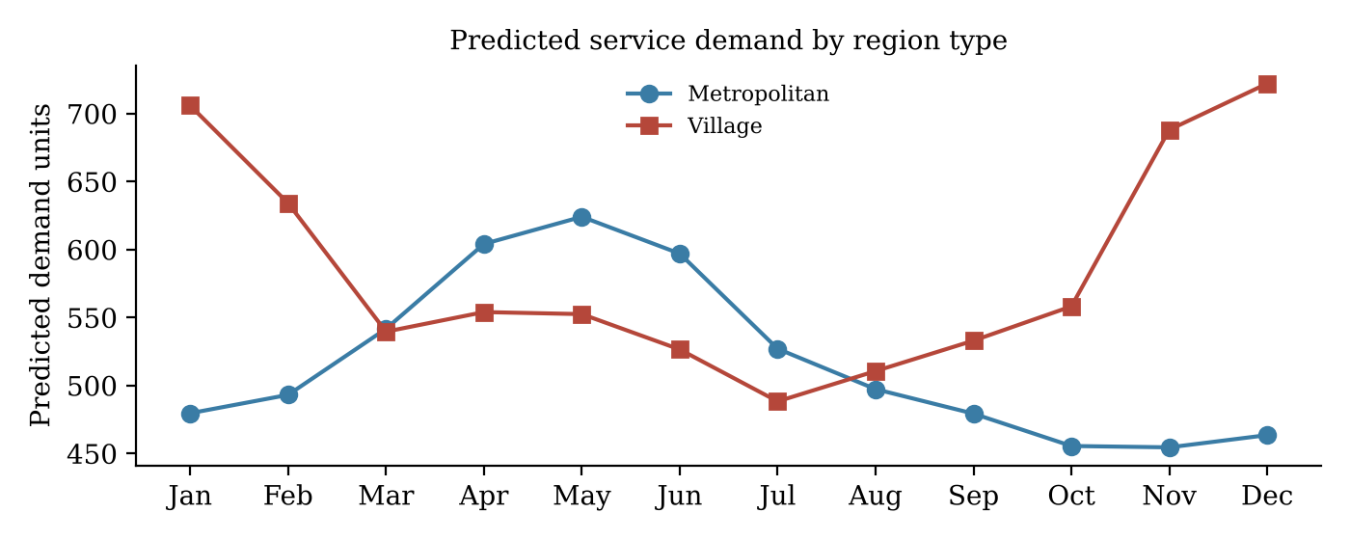
Business impact (simulated)
₹2.61 Cr
annual revenue
₹2.27 Cr
net profit, positive
in all 12 months
7.76×
revenue / operating cost
22.6%
saving vs. reactive
maintenance
Figures come from the business engine's default cost assumptions.

Slide 24
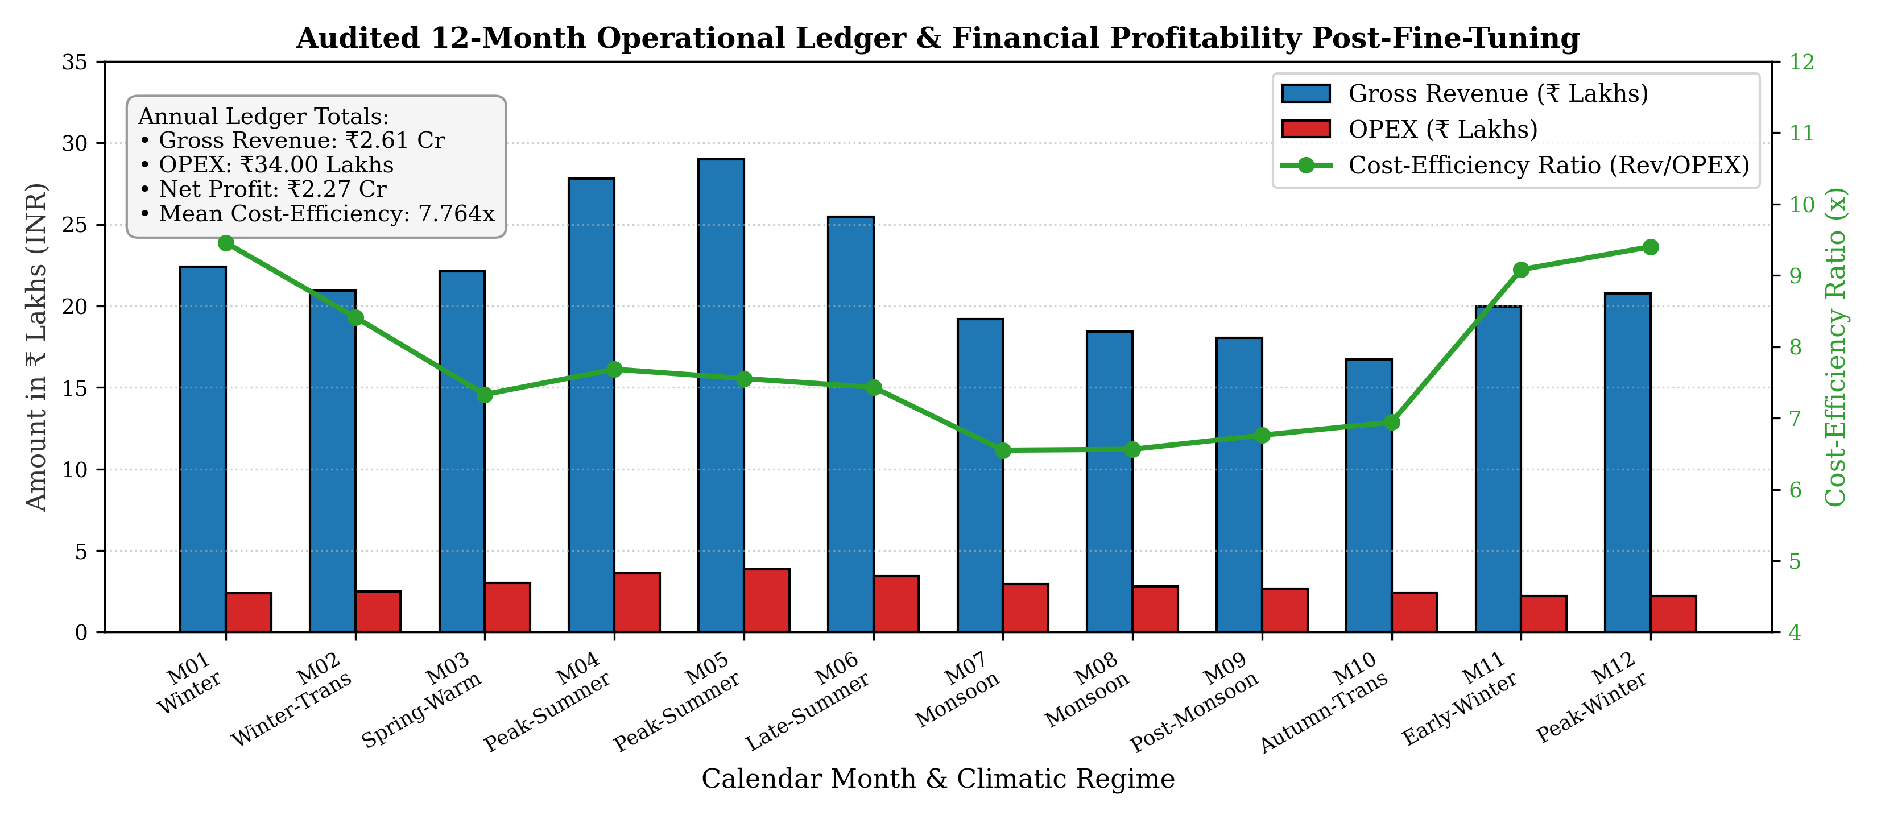
12-month financial ledger
Revenue vs. OPEX and cost-efficiency ratio (6.5× to 9.5×) for every month.
Simulated with the business engine's default cost assumptions.

Slide 25
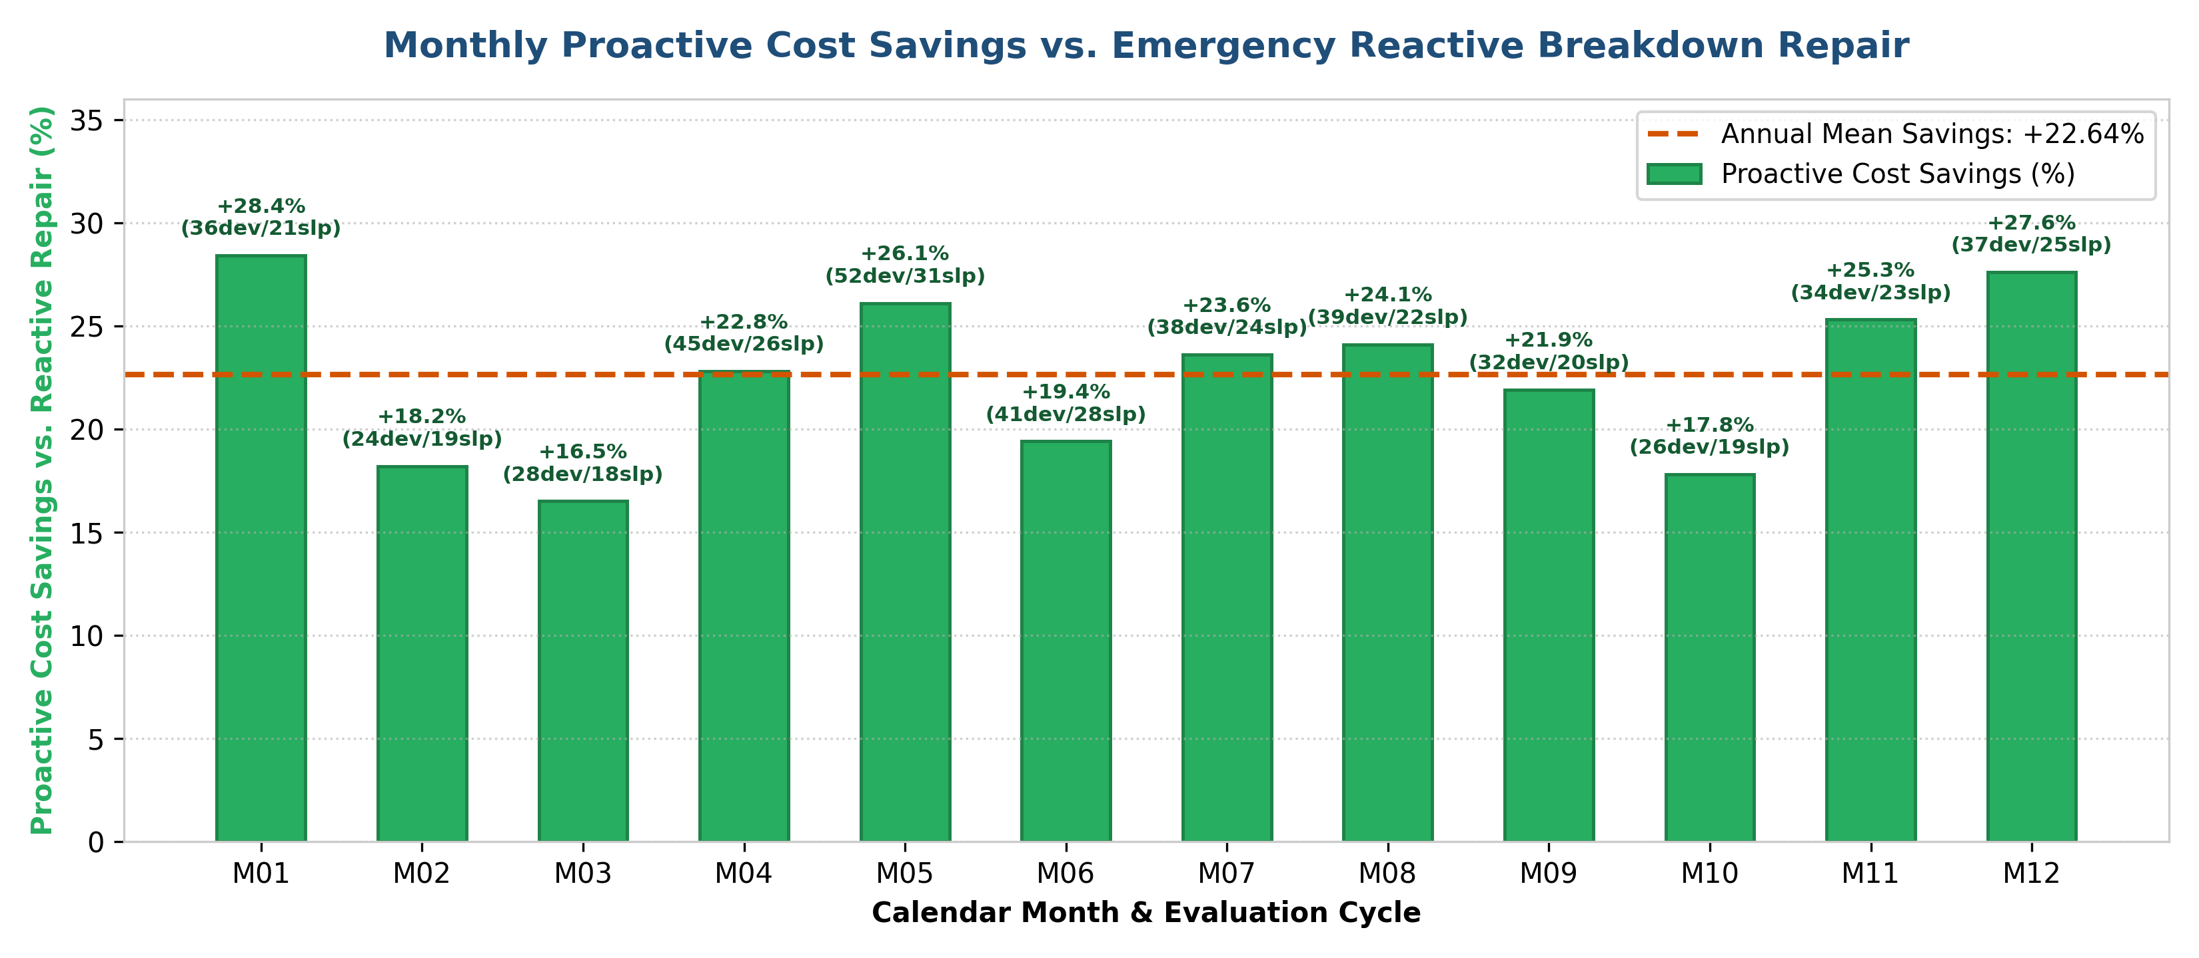
Proactive savings vs. reactive repair
Average saving 22.6%, highest in winter and peak summer.
Simulated with the business engine's default cost assumptions.

Slide 26
Model deployment
Streamlit web app
Offline dashboard
Neo4j graph DB
app.py on Streamlit Community Cloud, auto-redeploys on every GitHub push. Month slider, filters, business inputs and 7 tabs: graph, demand, devices, churn, parts, finance, Neo4j.
ARGOS_BROWSER_RESULTS.html: one HTML file with Chart.js charts that opens in any browser, no Python or internet needed.
All nodes and edges pushed over Bolt with ready Cypher queries; falls back to local PyTorch Geometric if Neo4j is down.
Artefacts served
fine_tuned_hetero_gnn_v100.pt (weights) · fine_tuned_financial_metrics.csv (12-month ledger) · fine_tune_telemetry.json (metrics + log)
Live at smarthvac-advisor.streamlit.app

Slide 27
Monitoring and maintenance
Covariate drift (weather)
Concept drift (wear, behaviour)
Heatwaves, late monsoon: KS test / PSI on temperature and humidity → update seasonal multipliers.
Alert if power MSE > 0.20 kW² (now 0.065) or failure F1 < 0.60 (now 0.697) → recalibrate and fine-tune.
Cadence | Action
Monthly | Load the new month snapshot, refresh predictions and ledger
Quarterly | Fine-tune with new service logs (fine_tune_v100.py)
Yearly | Full retrain + schema review: new devices, new locations
Every run writes a telemetry JSON (metrics, GPU memory, learned task weights) so a new model is compared before it is published.

Slide 28
Challenges and future work
Limitations
Next steps
Company graph and targets are simulated; the real datasets only calibrate them.
Scores are measured on the training graphs; there is no held-out test set yet.
₹ results depend on assumed costs and conversion rates.
Rare failures (≈2%) and mixed loss scales made training unstable at first.
Retrain on real HVAC service tickets and IoT sensor logs; test on a held-out year.
Compare with simple baselines (seasonal naïve, XGBoost per task).
Add live weather (e.g. Open-Meteo) and technician scheduling.
Calibrated probabilities and automatic drift alerts in the dashboard.

Slide 29
Conclusion
Built a 10-stage ML pipeline for an HVAC service business.
One heterogeneous graph + one multi-task GNN covers demand, maintenance, retention and inventory.
Fine-tuning cut the combined loss by 66% and lifted failure F1 to 0.70 and churn F1 to 0.65.
Predictions feed a business engine and a live Streamlit dashboard, with a drift-monitoring and retraining plan.
Next: validate on real company data with a proper test set.

Slide 30
Thank you

